Slide 1



Authoring SecretManagement Extension Vaults
Justin Grote [Microsoft MVP]
Datacenter Solutions Architect
@JustinWGrote
Slides: https://github.com/JustinGrote/Presentations
Notes:
Questions Between Slides
Audience: Windows Powershell users who either haven’t used Powershell Core 6 or Powershell 7 or have dipped their toes. Experts may pick some things up as well

Slide 2


Powershell Standard
Windows
Powershell
Powershell 7
.NET Framework
.NET Core
Windows
Linux / MacOS / More…
.NET Framework

Slide 3
powershell.exe
pwsh.exe
Windows
Powershell
Powershell 7
.NET Framework

Slide 4
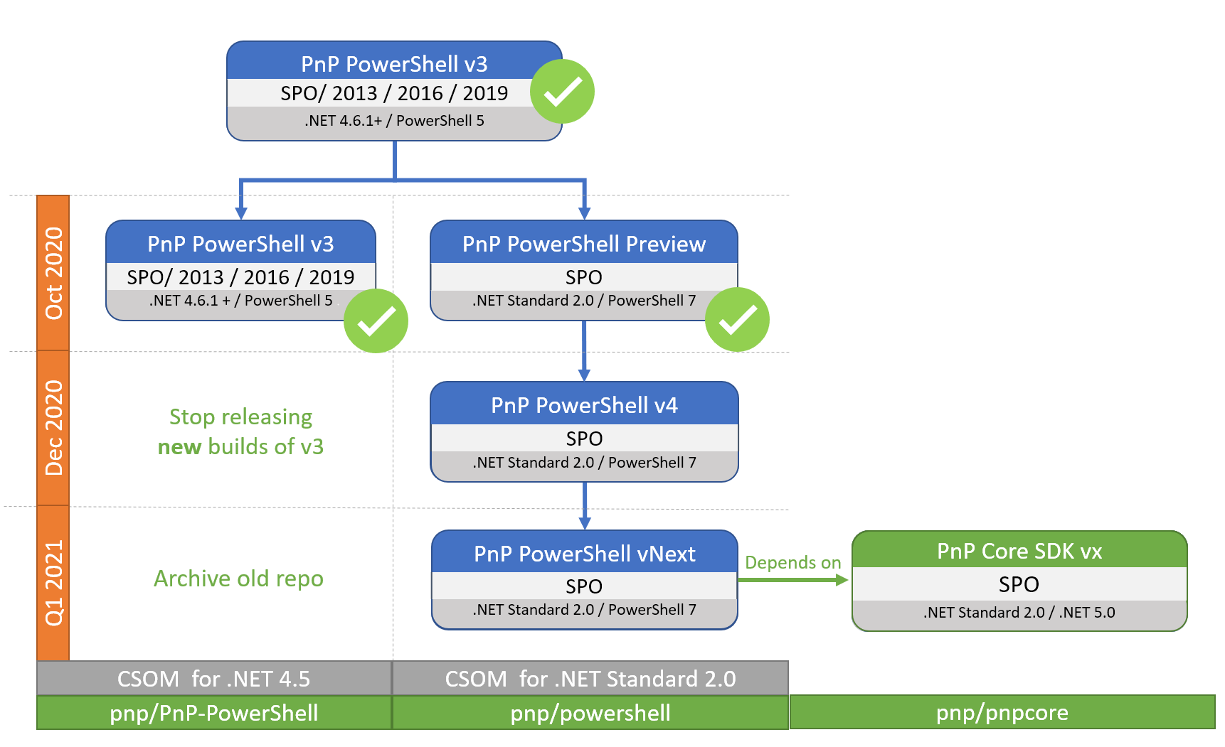

Slide 5
Demo Time…

Slide 6

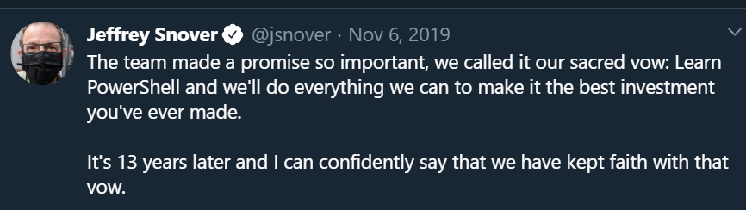
https://www.meetup.com/PowerShell_Chattanooga/events/270346146/
Using Visual Studio Code
As Your Default Powershell Editor
Tyler Leonhardt
ISE to VSCode Transition

Slide 8
Additional Reading

Slide 9
Thank you!
Justin Grote
Datacenter Solutions Architect @JustinGrote
NEXT: Finding value in Azure DevOps with your Dev Team – Samuel Greer
Slides: https://github.com/JustinGrote/Presentations
Notes:
Audience Poll
Who has tried Powershell Core or Powershell 7 at all?
Who are my Powershell 7 Gurus?
Who primarily uses Windows Powershell and/or ISE and is curious about Powershell 7?
***Hold Questions Till After Slides***

